Slide 1

Prison Law & Advocacy Conference (PLAC):
Working with and around the PLRA
Friday, Oct. 18, 2024

Slide 2
BUY THE BOOK
THE PLRA HANDBOOK:
LAW AND PRACTICE UNDER THE PRISON LITIGATION REFORM ACT
by John Boston
https://www.amazon.com/PLRA-Handbook-Practice-Prison-Litigation-ebook/dp/B09YBD9VTW/

Slide 3
Join and use the listserv
https://www.probono.net/prisoners/

Slide 4
Outline
Background statistics
Exhaustion (Developing law on unavailability)
Physical injury provision
Plaintiff types
  Organizational plaintiffs (including P&As)
  Non-prisoner plaintiffs
Prospective Relief:
  Findings
  Termination waivers
  Being prepared for a termination motion
Special Masters/Monitors/706 Experts
Notes:
Background statistics (Margo)
Exhaustion (Developing law on unavailability) (David)
Physical Injury provision
Plaintiff types (David and Oren)
Organizational plaintiffs (including P&As)
Non-prisoner plaintiffs
Settlement terms:
Findings (Margo)
Termination waivers (David)
Being prepared for a termination motion (all)
Special Masters/Monitors/706 Experts (Oren)

Slide 5
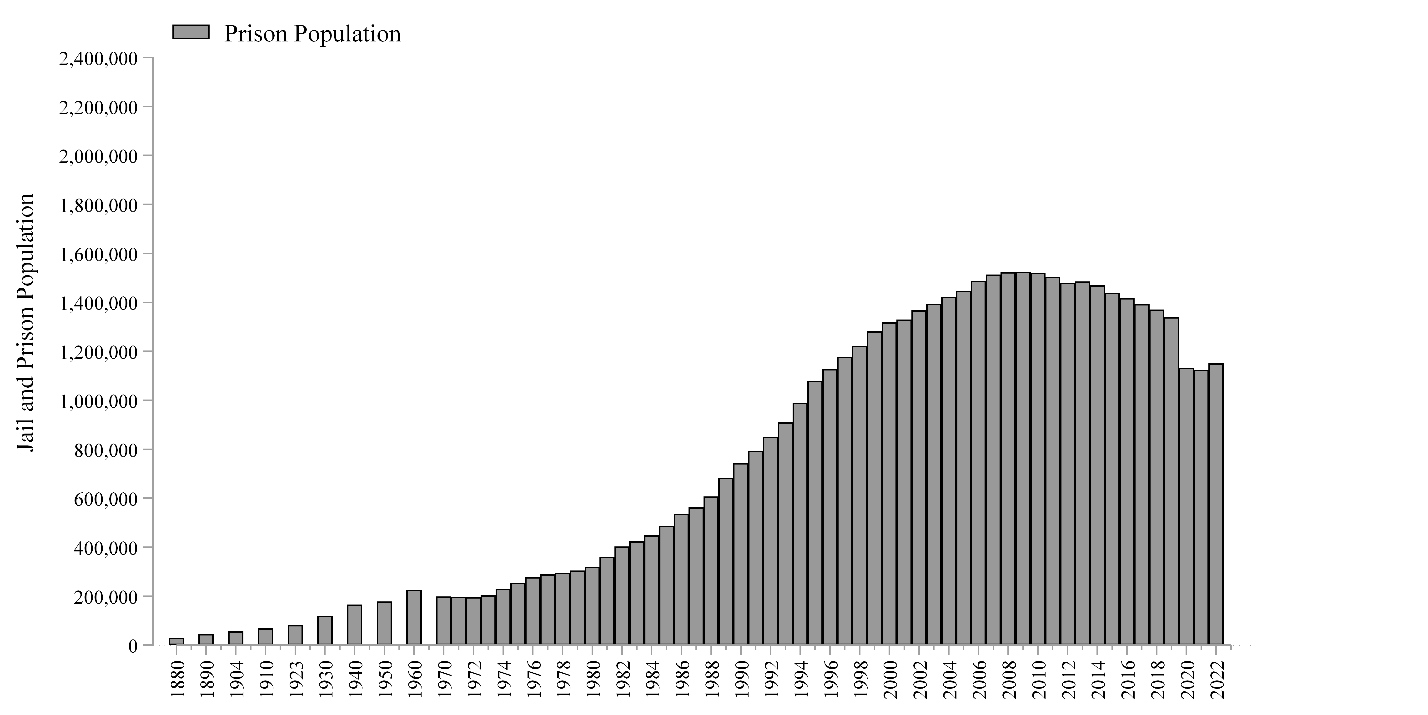

Slide 6
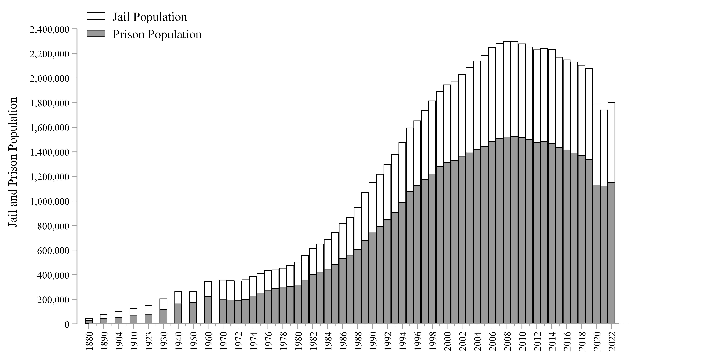

Slide 7
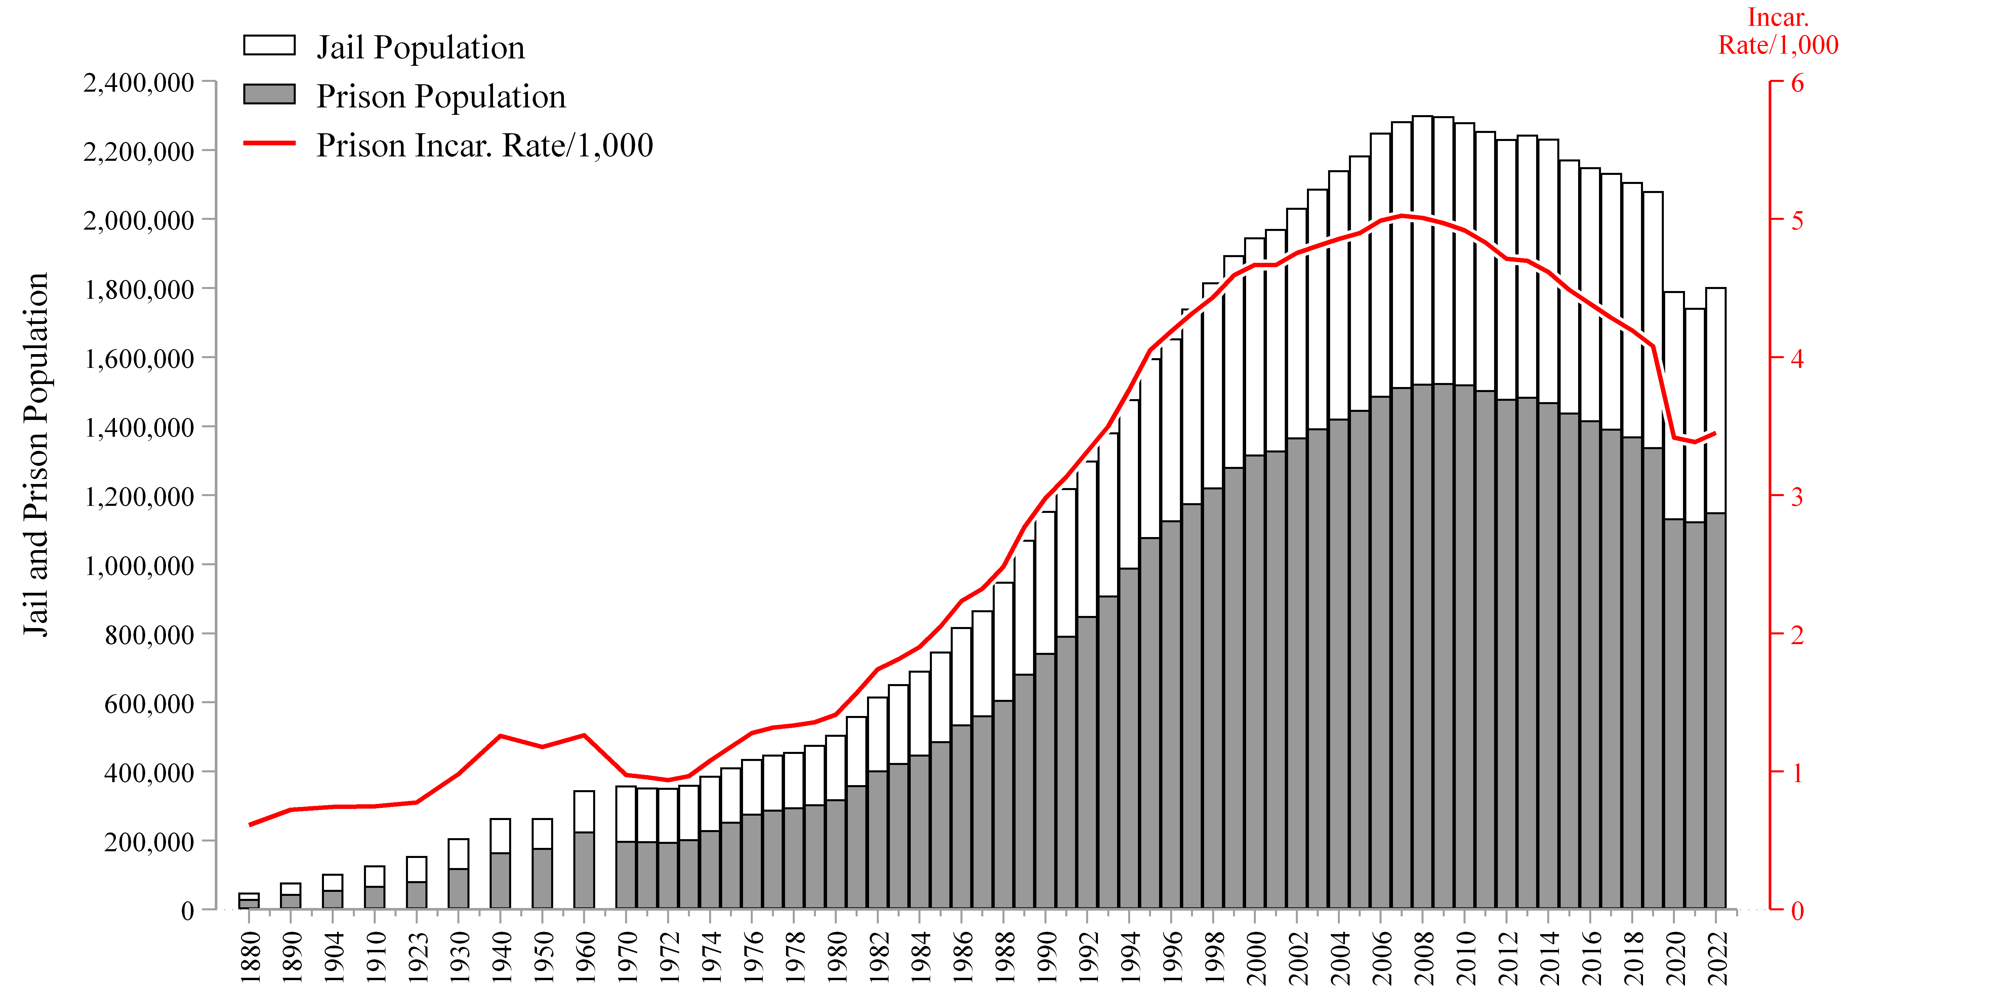

Slide 8
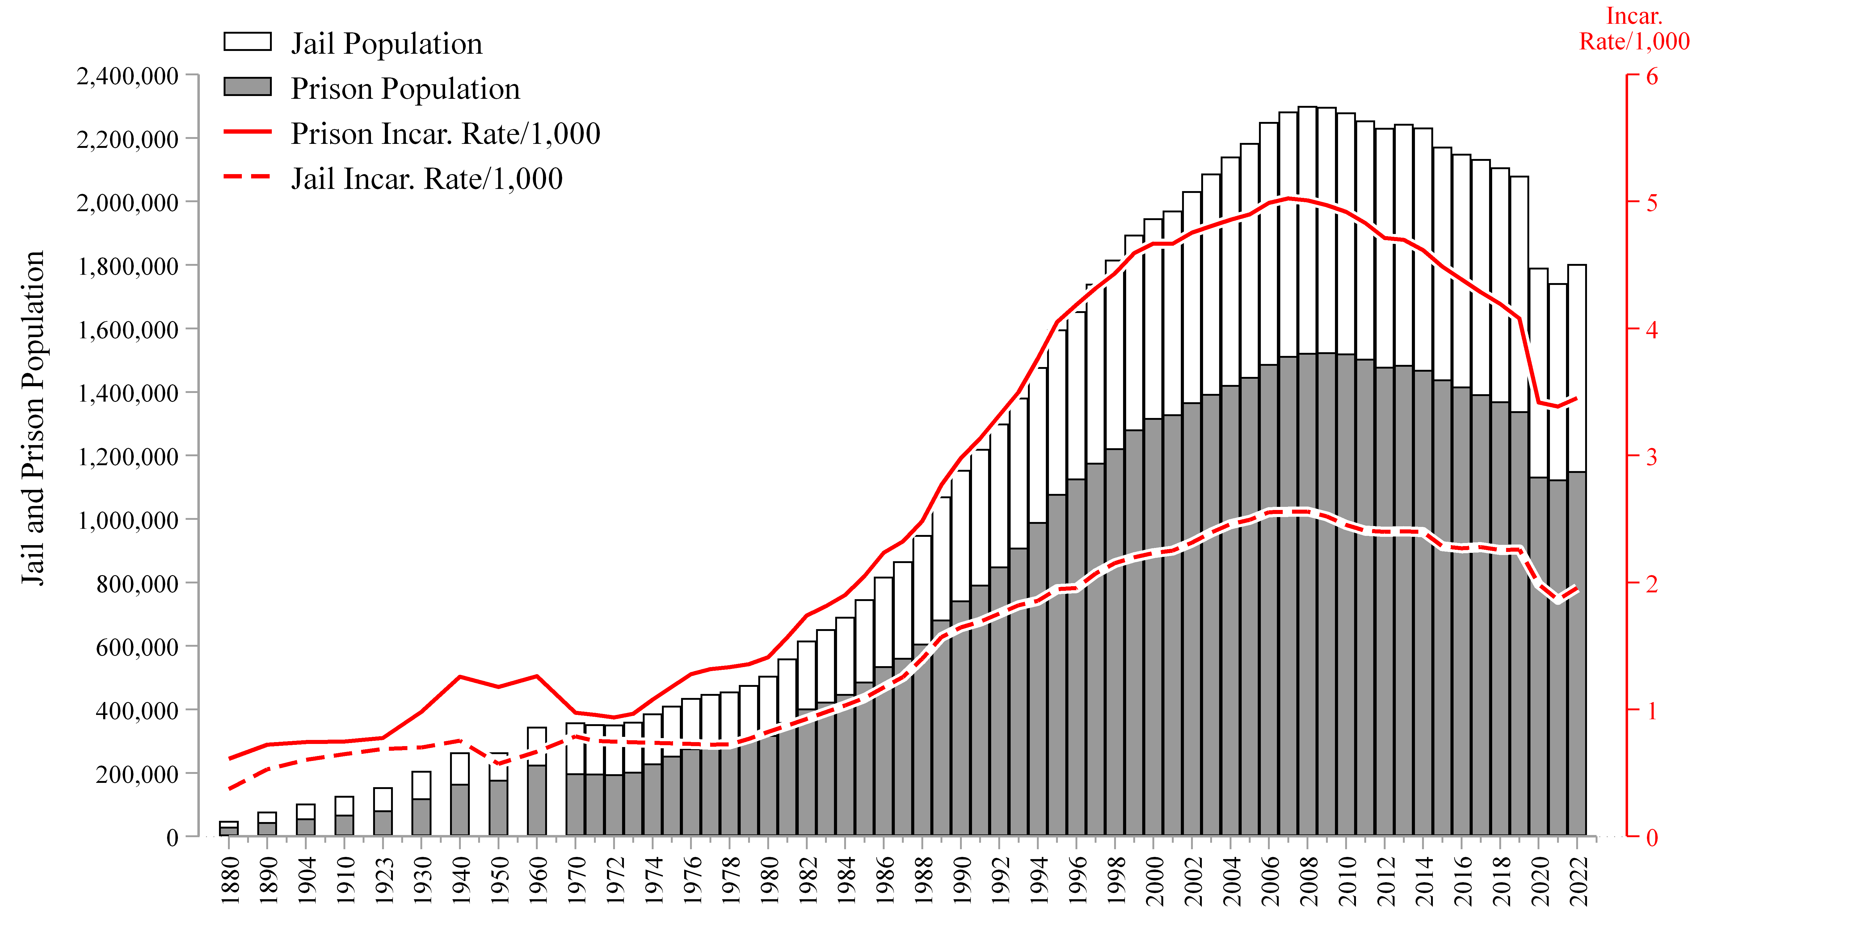

Slide 9
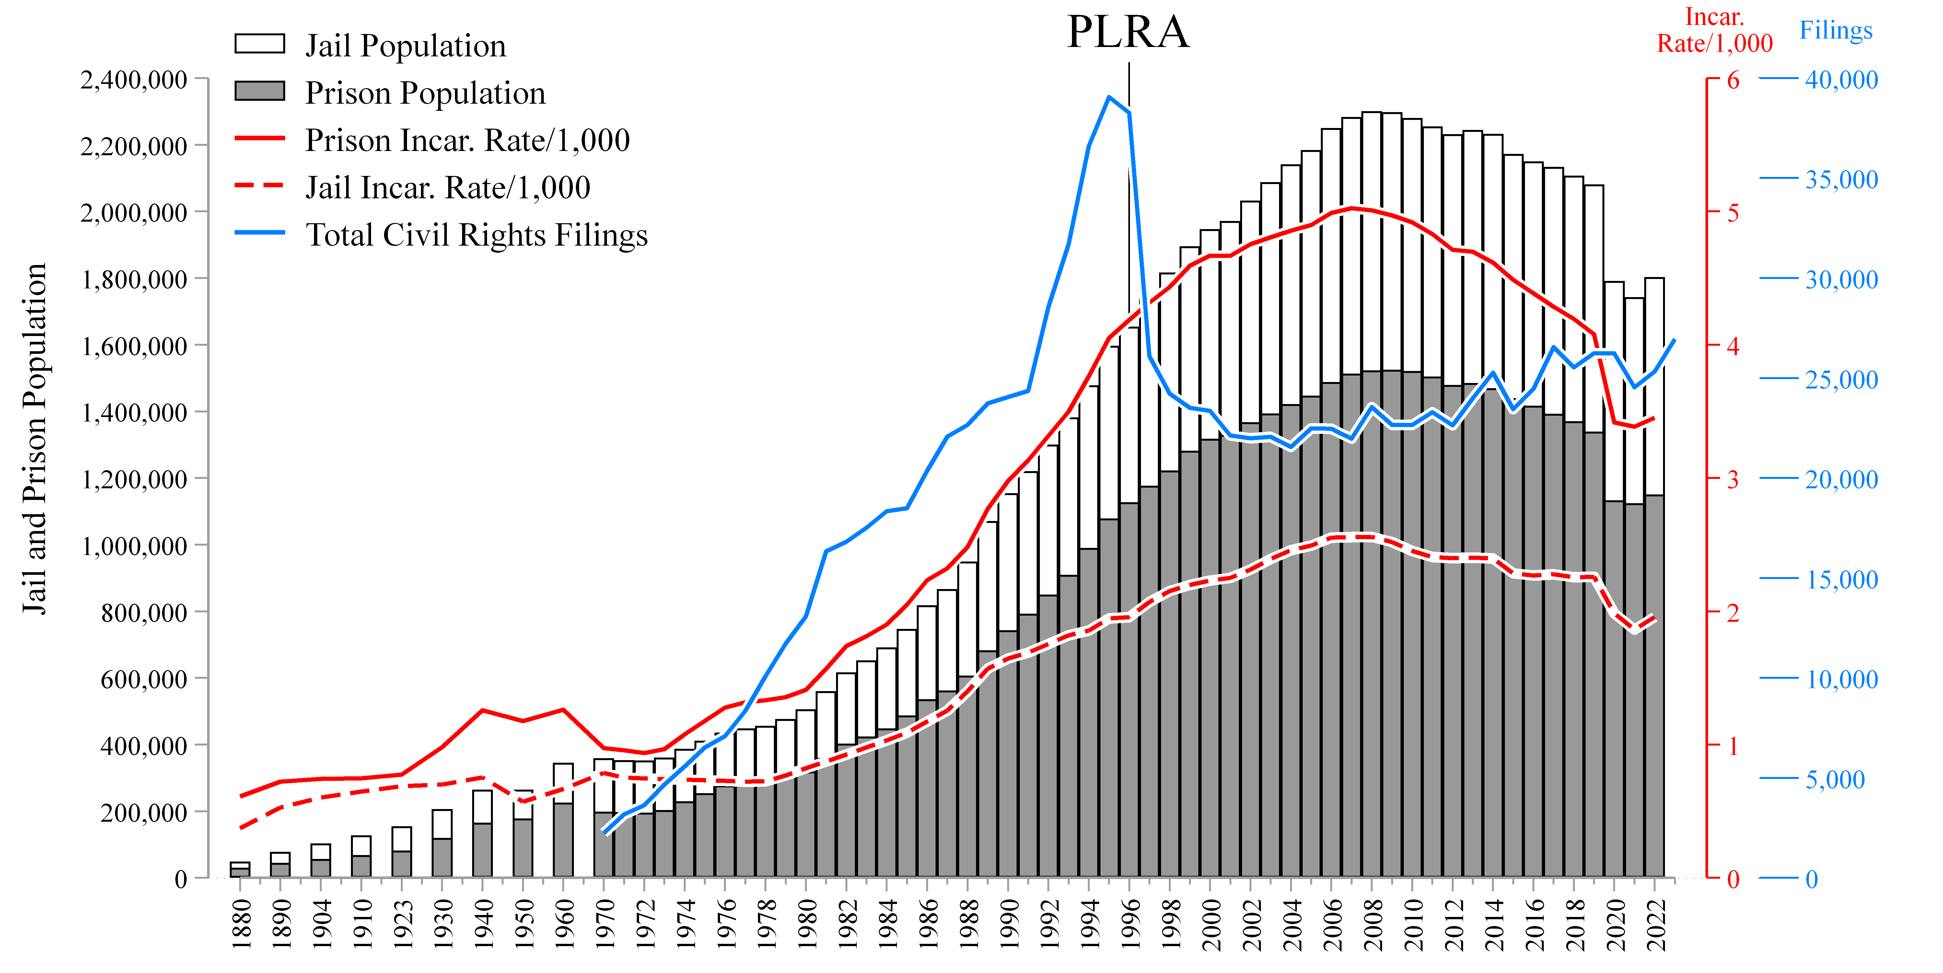

Slide 10
Shrinking Court Supervision

Slide 11
Shrinking Court Supervision

Slide 12
Shrinking Court Supervision

Slide 13
Shrinking Court Supervision

Slide 14
Shrinking Court Supervision

Slide 15
Shrinking Court Supervision

Slide 16
Outline
Background statistics
Exhaustion (Developing law on unavailability)
Physical injury provision
Plaintiff types
  Organizational plaintiffs (including P&As)
  Non-prisoner plaintiffs
Prospective Relief:
  Findings
  Termination waivers
  Being prepared for a termination motion
Special Masters/Monitors/706 Experts
Notes:
Background statistics (Margo)
Exhaustion (Developing law on unavailability) (David)
Physical Injury provision
Plaintiff types (David and Oren)
Organizational plaintiffs (including P&As)
Non-prisoner plaintiffs
Settlement terms:
Findings (Margo)
Termination waivers (David)
Being prepared for a termination motion (all)
Special Masters/Monitors/706 Experts (Oren)

Slide 17
Exhaustion under the PLRA
“No action shall be brought with respect to prison conditions under section 1983 of this title, or any other Federal law, by a prisoner confined in any jail, prison, or other correctional facility until such administrative remedies as are available are exhausted.”
42 U.S.C. § 1997e(a)

Slide 18
Exhaustion, 42 U.S.C. § 1997e(a)
Failed escape routes:
“with respect to prison conditions.”
“such administrative remedies as are available”
  This is a rule of procedural bar, not ripeness.
  There is no futility exception.

Slide 19
Exhaustion, 42 U.S.C. § 1997e(a)
Potentially available escape routes:
“under section 1983 of this title, or any other Federal law.” So use state law
“by a prisoner”. So sue after release, or make the plaintiff a non-prisoner (family member, P&A, etc.)
“such administrative remedies as are available”: Were administrative remedies available? See Ross v. Blake (and next slide)

Slide 20
Ross v. Blake, 578 U.S. 632 (2016)
“A prisoner need not exhaust remedies if they are not ‘available.’” Id. at 636.
A remedy is available only if it is “accessible or may be obtained” and if it is “capable of use for the accomplishment of a purpose.” Id. at 642
And a remedy is capable of use only if the prisoner can use it to “obtain relief.” Id. at 643.

Slide 21
Forms of unavailability
“[A]n administrative procedure is unavailable when (despite what regulations or guidance materials may promise) it operates as a simple dead end—with officers unable or consistently unwilling to provide any relief to aggrieved inmates.” Id. at 643.
“[A]n administrative scheme might be so opaque that it becomes, practically speaking, incapable of use. In this situation, some mechanism exists to provide relief, but no ordinary prisoner can discern or navigate it.” Id. at 643-44.

Slide 22
Forms of unavailability (cont’d)
“And finally, the same is true when prison administrators thwart inmates from taking advantage of a grievance process through machination, misrepresentation, or intimidation.” Id. at 644.

Slide 23
Ross’s three forms of unavailability are illustrative, not exhaustive
Ramirez v. Young, 906 F.3d 530, 538 (7th Cir. 2018) (“these were only examples, not a closed list, and to the extent the district court thought they were the latter, it erred.”).
Andres v. Marshall, 867 F.3d 1076, 1078 (9th Cir. 2017) (per curiam) (“By way of a non-exhaustive list, the Court recognized three circumstances in which an administrative remedy was not capable of use to obtain relief[.]”).

Slide 24
Ross’s three forms of unavailability are illustrative, not exhaustive
Williams v. Priatno, 829 F.3d 118, 125 n.2 (2d Cir. 2016) (“We note that the three circumstances discussed in Ross do not appear to be exhaustive”).
See also Muhammad v. Mayfield, 933 F.3d 993, 1000 (8th Cir. 2019) (referring to “at least” three categories of unavailability).

Slide 25
Examples of individualized unavailability
Smallwood v. Williams, 59 F.4th 306 (7th Cir. 2023) (fact issues existed as to whether grievance procedure was unavailable to prisoner based on his allegedly low IQ and lack of access to anyone who might help him while he was in restrictive housing).
Eaton v. Blewett, 50 F.4th 1240, 1245 (9th Cir. 2022) (“The critical question, here, is whether ‘there is something in [the prisoner’s] particular case that made the existing and generally available administrative remedies effectively unavailable to [him].’”).
Rucker v. Giffen, 997 F.3d 88, 94 (2d Cir. 2021) (concluding that a grievance procedure was unavailable to a prisoner who could not comply with its terms due to his medical condition).

Slide 26
Non-exhaustion is an affirmative defense
“We conclude that failure to exhaust is an affirmative defense under the PLRA, and that inmates are not required to specially plead or demonstrate exhaustion in their complaints.”
Jones v. Bock, 549 U.S. 199, 216 (2007) (Roberts, C.J., for a unanimous Court).

Slide 27
Defendants have the burden of proving availability and non-exhaustion
See, e.g, Lanaghan v. Koch, 902 F.3d 683, 690 (7th Cir. 2018) (holding defendants “have not met their burden of establishing that a remedy was available” to the plaintiff when they “did not present evidence” that plaintiff was aware of relevant grievance rules).
Albino v. Baca, 747 F.3d 1162, 1172 (9th Cir. 2014) (“as required by Jones, the ultimate burden of proof remains with the defendant.”).

Slide 28
Outline
Background statistics
Exhaustion (Developing law on unavailability)
Physical injury provision
Plaintiff types
  Organizational plaintiffs (including P&As)
  Non-prisoner plaintiffs
Prospective Relief:
  Findings
  Termination waivers
  Being prepared for a termination motion
Special Masters/Monitors/706 Experts
Notes:
Background statistics (Margo)
Exhaustion (Developing law on unavailability) (David)
Physical Injury provision
Plaintiff types (David and Oren)
Organizational plaintiffs (including P&As)
Non-prisoner plaintiffs
Settlement terms:
Findings (Margo)
Termination waivers (David)
Being prepared for a termination motion (all)
Special Masters/Monitors/706 Experts (Oren)

Slide 29
Physical Injury Requirement
42 U.S.C. § 1997e(e):
“No Federal civil action may be brought by a prisoner confined in a jail, prison, or other correctional facility, for mental or emotional injury suffered while in custody without a prior showing of physical injury or the commission of a sexual act (as defined in section 2246 of title 18, United States Code).”
worst written provision of the PLRA; confusion in the courts

Slide 30
What does the statute do?
Unless actual physical injury, provision bars compensatory damages
Limit on damages, not “actions”
Injunctive and declaratory relief is not affected
Leaves nominal and punitive damages intact (except D.C. Circuit)

Slide 31
Is a violation of intangible civil liberties a mental or emotional injury? Circuit Split
The broad reading: Anything that isn’t physical is “metal or emotional”
The narrow reading:
King v. Zamiara, F.3d 207 (6th Cir. 2015):
  The broad reading “does not accord with the statutory language: The statute . . . . Says nothing about claims brought to redress constitutional injuries, which are distinct from mental and emotional injuries. . . . Were we to construe § 1997e(e) as the majority of courts have done, thereby grafting a physical-injury requirement onto claims that allege First Amendment violations as the injury, the phrase “for mental or emotional injury” would be rendered superfluous.”
Hacker v. Dart, 62 F.4th 1073 (7th Cir. 2023)
  provision doesn’t cover cover “[c]ertain dignitary harms, like violations of particular constitutional rights”

Slide 32
What constitutes physical injury?
Not defined in the statute
At least six circuits have said that “de minimis” injuries are insufficient. This seems wrong, given that elsewhere the statute specifies “serious physical injury.”
  “headaches, weakness, cold sweats, dizziness, weight loss, numbness in his left arm, and high blood sugar that caused fainting” represented more than de minimis physical injury since they constituted “continuing severe physical pain and other symptoms that persisted for an extended period of time and required medical treatment”)
  not even clear whether actions that approach or amount to torture are compensable under § 1997e(e)

Slide 33
What constitutes physical injury?
Comparison to “bodily injury” as elsewhere defined (18 U.S.C. § 831(g)(5) (prohibited acts involving nuclear materials); id. § 1365(h)(4) (tampering with consumer products); id. § 1515(a)(5) (definitions for obstruction of justice or other official proceedings); id. § 1864(d)(2) (hazardous or injurious devices on federal lands).
“a cut, abrasion, bruise, burn, or disfigurement,”
“physical pain,” and
“any other injury to the body, no matter how temporary.”
Bell v. Williams, 108 F.4th 809 (9th Cir. 2024 ):
no “daylight between those two terms”

Slide 34
Physical injury work-arounds
Strategies:
“Brought by a prisoner.” No SOL problems; dismiss w/out prejudice and file post-release
Demonstrate physical injury
Plead explicitly that you do not seek compensatory damages for mental or emotional injury; you seek compensation for loss of liberty or for the objective conditions to which the plaintiff was subjected, plus punitive and nominal damages

Slide 35
Outline
Background statistics
Exhaustion (Developing law on unavailability)
Physical injury provision
Plaintiff types
  Organizational plaintiffs (including P&As)
  Non-prisoner plaintiffs
Prospective Relief:
  Findings
  Termination waivers
  Being prepared for a termination motion
Special Masters/Monitors/706 Experts
Notes:
Background statistics (Margo)
Exhaustion (Developing law on unavailability) (David)
Physical Injury provision
Plaintiff types (David and Oren)
Organizational plaintiffs (including P&As)
Non-prisoner plaintiffs
Settlement terms:
Findings (Margo)
Termination waivers (David)
Being prepared for a termination motion (all)
Special Masters/Monitors/706 Experts (Oren)

Slide 36
Plaintiff types
Think PLRA provision by PLRA provision. Some provisions (3626) cover “prison conditions”. Others cover “prisoners”. Others cover in forma pauperis filers.
Where a provision covers “prisoners” (e.g., exhaustion):
Non-prisoner plaintiffs
Organizational plaintiffs (including P&As)

Slide 37
Outline
Background statistics
Exhaustion (Developing law on unavailability)
Physical injury provision
Plaintiff types
  Organizational plaintiffs (including P&As)
  Non-prisoner plaintiffs
Prospective Relief:
  Findings
  Termination waivers
  Being prepared for a termination motion
Special Masters/Monitors/706 Experts
Notes:
Background statistics (Margo)
Exhaustion (Developing law on unavailability) (David)
Physical Injury provision
Plaintiff types (David and Oren)
Organizational plaintiffs (including P&As)
Non-prisoner plaintiffs
Settlement terms:
Findings (Margo)
Termination waivers (David)
Being prepared for a termination motion (all)
Special Masters/Monitors/706 Experts (Oren)

Slide 38
Prospective Relief
Challenges and Responses
Satisfy the PLRA’s prerequisites to court-enforceable orders.
Enter a “private settlement agreement” – that might, in the end, be enforceable.
Guard by stipulation against premature termination motion.
Seek settlement or decree terms that help you prepare for a termination motion.

Slide 39
Prospective Relief
Needs/Narrowness (18 U.S.C. 3626(a)(1)
Prospective relief in any civil action with respect to prison conditions shall extend no further than necessary to correct the violation of the Federal right of a particular plaintiff or plaintiffs.
The court shall not grant or approve any prospective relief unless the court finds that such relief is narrowly drawn, extends no further than necessary to correct the violation of the Federal right, and is the least intrusive means necessary to correct the violation of the Federal right.
The court shall give substantial weight to any adverse impact on public safety or the operation of a criminal justice system caused by the relief.

Slide 40
a) Supporting the 3626(a)(1) Findings
Statute gives judges excuse not to act.
If your judge is willing to act, you must provide enough evidence for 3626(a)(1) findings to be sustained on appeal.

Slide 41
How to Support the Findings
Caselaw:
“Agreements between the parties” are “‘strong evidence,’ if not dispositive, that provisions reflecting those agreements comply with the needs-narrowness-intrusiveness requirement.”
Benjamin v. Fraser, 156 F. Supp. 2d 333, 344 (S.D.N.Y. 2001)
“[W]e do not mean to suggest that the district court must conduct an evidentiary hearing about or enter particularized findings concerning any facts or factors about which there is not dispute. The parties are free to make any concessions or enter into any stipulations they deem appropriate.”
Cason v. Seckinger, 231 F.3d 777 (11th Cir. 2000)

Slide 42
Magic Words?
Stipulation by statutory citation: The court shall find that this Stipulation satisfies the requirements of 18 U.S.C. §3626(a)(1)(A) and shall retain jurisdiction to enforce its terms.
Stipulation by statutory quotation: The parties stipulate, based upon the entire record, that the relief set forth in this Settlement Agreement is narrowly drawn, extends no further than necessary to correct violations of federal rights, and is the least intrusive means necessary to correct violations of federal rights.
Stipulation to necessity to correct “the alleged violation.” The Court finds that the relief provided in the [Proposed Settlement Agreement] is narrowly drawn and extends no further than necessary to correct the alleged violation in conformance with the Prison Litigation Reform Act, 18 U.S.C. § [3626](a)(1)

Slide 43
Magic Words?
The relief granted herein is narrowly drawn, extends no further than necessary to correct a violation of a federal right, and is the least intrusive means necessary to correct the violation of a federal right. Nothing in this Order and Agreement, including, specifically, the stipulation . . . constitutes an admission of liability and undersigned Defendants.
The stipulation set forth . . . is included expressly to facilitate the parties’ intent to enable the Court to: retain jurisdiction for the desired term; and if necessary, entertain any future plaintiffs’ motion to enforce the terms of this Order and Agreement. The stipulation may not be relied on as precedent in any future claim, without prejudice or limitation, however, to plaintiffs’ ability to enforce the terms of this Order and Agreement.

Slide 44
b) Private Settlement Agreements
“[R]elief includes consent decrees but does not include private settlement agreements.” 18 U.S.C. 3626(g)(9)
Private settlement agreements are: “agreement[s] entered into among the parties that [are] not subject to judicial enforcement other than the reinstatement of the civil proceeding that the agreement settled.” (g)(6)
Does not “preclude parties from entering into a private settlement agreement that does not comply with the limitations on relief . . . if the terms of that agreement are not subject to court enforcement other than the reinstatement of the civil proceeding that the agreement settled.” (c)(2)
Remedies for breach of a “private settlement agreement” may be sought in state court. (c)(2).

Slide 45
Private Settlement by Conditional Dismissal
Example 1: Reinstatment:
“Pursuant to 18 U.S.C. § 3626(c)(2), during the term of the Agreement, plaintiffs may move the court for reinstatement of the lawsuit, or may elect to proceed in state court and seek specific performance or institute an action for breach.... This Agreement is a private settlement agreement within the meaning of 18 U.S.C. § 3626.
→ “ORDERED that by consent of the parties and consistent with 18 U.S.C. § 3626(c)(2), the Court shall retain jurisdiction pursuant to Kokkonen v. Guardian Life Insurance Co. of America, 511 U.S. 375 (1994) through October 18, 2015 for the limited purpose of reinstating this lawsuit under the terms of the Agreement.”

Slide 46
Private Settlement by Conditional Dismissal
Example 2: Enforcement
“If the Court finds that the D is in substantial non-compliance with a provision or provisions of this Settlement Agreement, it may enter an order consistent with equitable principles, but not an order of contempt, that is designed to achieve compliance.
And then, escalation:
“If P contends that the Department has not complied with an order entered under the preceding paragraph, it may, after reasonable notice to the Department, move for further relief from the Court to obtain compliance with the Court’s prior order. In ruling on such a motion, the Court may apply equitable principles and may use any appropriate equitable or remedial power then available to it.”

Slide 47
Blur: Stipulate to Enforceability
WHEREAS, the Department confirms, agrees and acknowledges, that it will perform the obligations and duties set forth in the Settlement Agreement . . .
The Parties hereby move and respectfully request the order and entry of the attached proposed Consent Judgment. The Parties respectfully request that this Court retain jurisdiction to enforce the Consent Judgment.

Slide 48
c) Stipulations that guard against premature termination motions.
3626(b)(1) Termination of prospective relief.‑‑(A) In any civil action with respect to prison conditions in which prospective relief is ordered, such relief shall be terminable upon the motion of any party or intervener‑‑
  (i) 2 years after the date the court granted or approved the prospective relief;
  (ii) 1 year after the date the court has entered an order denying termination of prospective relief under this paragraph; or
  (iii) in the case of an order issued on or before the date of enactment of the Prison Litigation Reform Act, 2 years after such date of enactment.
(B) Nothing in this section shall prevent the parties from agreeing to terminate or modify relief before the relief is terminated under subparagraph (A).

Slide 49
c) Stipulations that guard against premature termination motions.
Opt-out: “The Defendants will not file any motion in the future asserting that this Stipulated Settlement should be terminated under the Prison Litigation Reform Act.”
Lengthen the pre-termination period:
  “In order to give the provisions contained herein an opportunity to be implemented and evaluated, both parties agree not to challenge this agreement for a period of four years.”
  “Defendants shall not file a termination motion until they have achieved a minimum of one year of substantial compliance with the provisions of this Consent Injunction.”

Slide 50
d) Terms to prepare for termination motions
Information Gathering 1: Raw Data
“Quarterly, Defendants shall provide to Plaintiffs’ Counsel the physician sick call schedule for the previous month, including the name of each physician who worked, the actual days he or she was present at the Jail, the actual number of hours he or she spent at the Jail on each of these days, and how many patients he or she treated on each of these days.”
Listing names and locations:
  reveals compliance problems where they exist
  makes compliance reporting less impressionistic, more accurate
  provides names of potential interviewees
Pressures the defendants to more comprehensive compliance and eases preparation against termination

Slide 51
Information Gathering 2: Deft Reports
“Defendants shall submit quarterly compliance reports to the Court. The reports shall describe the actions the Defendants have taken during the reporting period to implement this Decree and shall make specific reference to the Decree provisions being implemented.”
Encourages progress, so Defendants can report on it.
Informs Plaintiffs’ counsel in advance what Defendants will say, facilitating speedy and effective response to termination motion.

Slide 52
Information Gathering 3: Access
“Plaintiffs’ counsel shall have reasonable access to Jail records, Jail inmates, and the Jail facility, including escorted, unannounced walk-through visits of the Jail on a quarterly basis. . . . Should class counsel bring a medical expert, the medical expert shall have access to all medical records and charts kept or created by the Jail.”
Allows plaintiffs’ counsel to:
  maintain good working knowledge
  maintain relationships with clients (who have detailed and current information)

Slide 53
Outline
Background statistics
Exhaustion (Developing law on unavailability)
Physical injury provision
Plaintiff types
  Organizational plaintiffs (including P&As)
  Non-prisoner plaintiffs
Prospective Relief:
  Findings
  Termination waivers
  Being prepared for a termination motion
Special Masters/Monitors/706 Experts
Notes:
Background statistics (Margo)
Exhaustion (Developing law on unavailability) (David)
Physical Injury provision
Plaintiff types (David and Oren)
Organizational plaintiffs (including P&As)
Non-prisoner plaintiffs
Settlement terms:
Findings (Margo)
Termination waivers (David)
Being prepared for a termination motion (all)
Special Masters/Monitors/706 Experts (Oren)

